Slide 1
Engaged Learning and Beyond
Practical, ready to use activities to increase engaged learning with middle level students.
Two tasks to accomplish before we begin:
1) Please pick up a packet of my slide show presentation with extra notes for you. Thanks!
2) Pick up one of the pieces of pipe from the bucket and take it to your spot.

Slide 2
A bit about me, a bit about you
Allow me to share a bit about where I teach and the journey to finding middle school as my love and passion!
Share with me where you are in your journey.

Slide 3
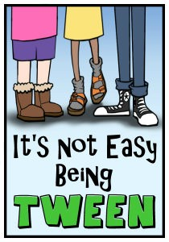
Our Students- Who Are They?
Teaching middle school is unlike any other level of education. Early adolescents are not just large elementary school children, nor are they small adults. They are a unique animal with their own quirks and characteristics.

Slide 4
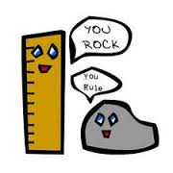
Why Middle School Rocks!
Variety
Honesty
Quirks
Curiosity
Impact
Laughter

Slide 5
Experience based methods for setting the stage for middle school learning As Todd Whittaker says in What Great Teachers Do Differently, “Every teacher has an impact. Great teachers make a difference.”
Set the tone early with expectations and respect
Model, model, model
Get to know your students
Listen to your students
Model, model, model (again and always ☺)

Slide 6
Ideas for setting the stage for learning…
1. Set up your classroom to be user friendly for your students. (students know where everything is located, from pencil sharpeners to scissors to band aids!)
2. Take the time at the beginning of the year to get to know your students. (see example pages 8-12) I am a firm believer that to teach a student well, you must know them well.
3. Take the time at the beginning of the year to model expectations. (see attached matrix and expectation sheet pages 13-16) Run a tight ship when giving instructions.
4. Set up methods of getting students to talk with others, form groups, and create conversation. (see example page 17)

Slide 7
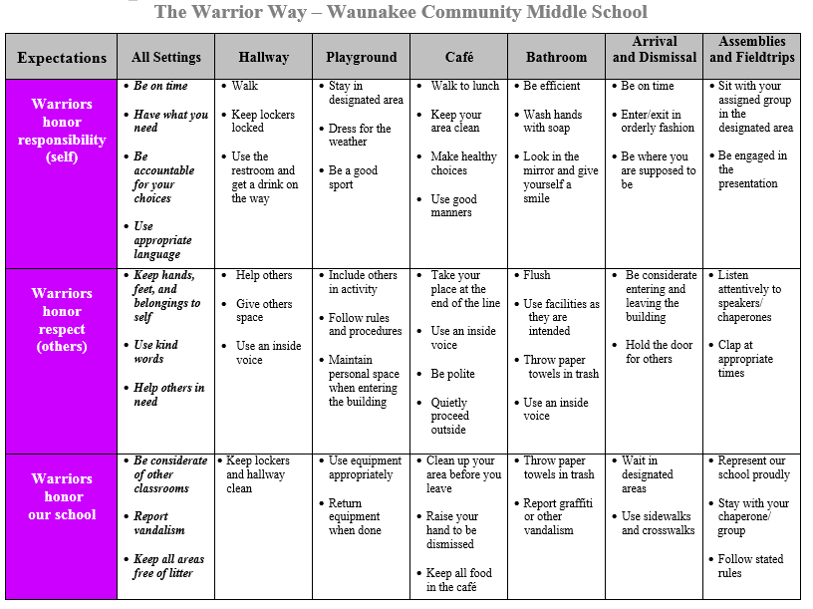
Using a Matrix to Model Expected Behaviors (schoolwide)

Slide 8
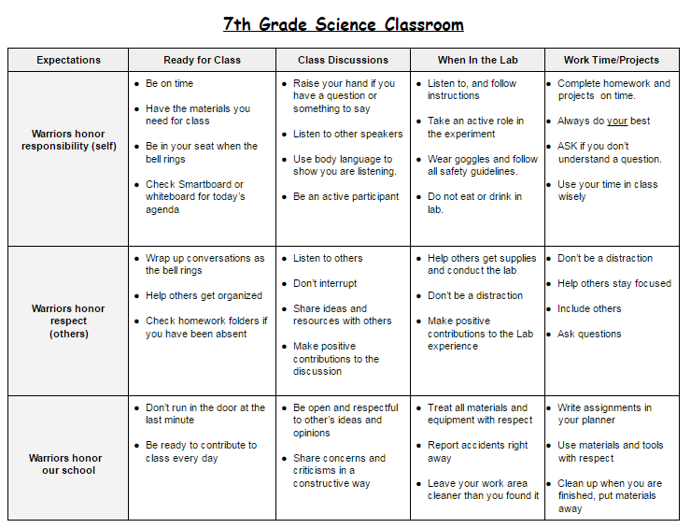
Using A Matrix to Model Expected Behaviors (specific to classroom)

Slide 9
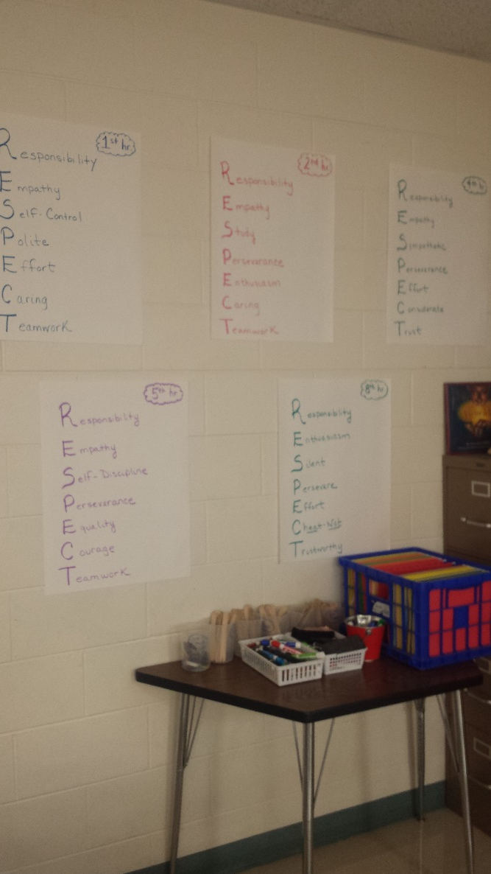
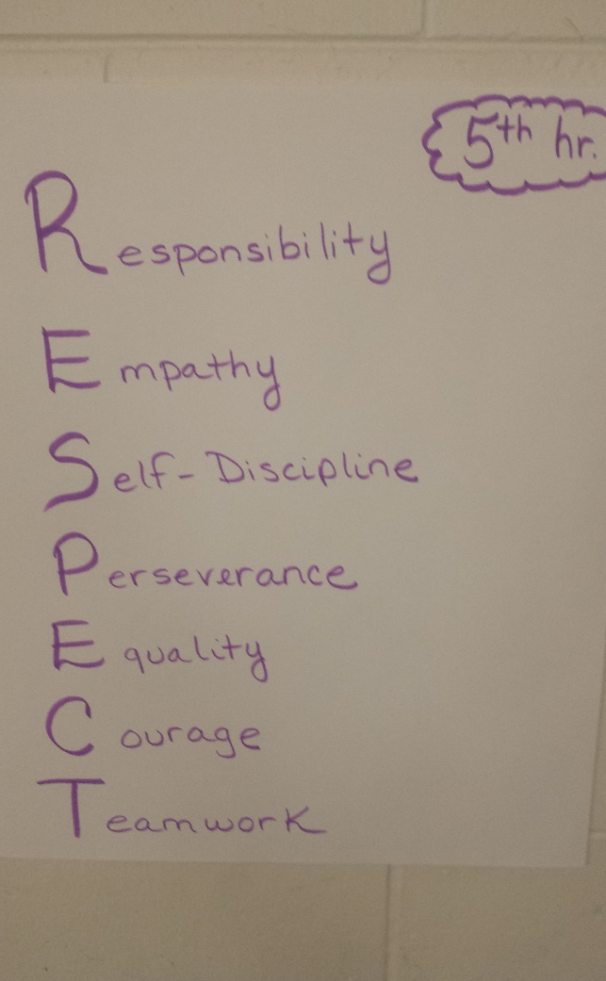
Set the tone early with expectations and respect. Trust and respect cannot be taught…they must be learned.

Slide 10
Our students basic needs for learning:
1) Students must feel safe, 2) Students must feel valued, and 3) Students must feel successful.
How do we meet these basic needs as teachers? We earn their trust, we earn their respect and we continually provide them with engaging activities!!

Slide 11
Activity Time: (see page 18)
Pipe Activity- learning to work together, learning what works well and what does not, much to discuss with students
Great beginning of the year exercise to discuss what goes into teamwork, why we need teamwork in our classrooms.
It is also a great reminder activity. Mid year, towards the end of the year. Compare our activity results with our posters. It is also a great competition between classes to get students motivated.

Slide 12
Teambuilding Challenge The object: Get the marble in the container following these rules. 1. You may not purposefully touch the marble with your hand except the first person who puts the marble on their trough. 2. You may not overlap another person’s trough. 3. You may not touch anyone’s trough but your own. 4. You may not block the end of your trough. 5. Marble may not go backwards. 6. Marble must go on everyone’s trough. 7. The end container must remain on the floor. 8. You will be timed to see how long it takes. If you complete it once, trade troughs and positions and try again for a better time.

Slide 13
Conversation Partner Activity
Conversation Partners Conversation Partners:
Bowling Buddy: Louis Pasteur:
Swimming Chum: Jane Goodall:
Hiking Pal: Marie Curie:
Mountain Climbing Gregor Mendel:
Companion:
When and how to use conversation partners in the classroom.

Slide 14
Conversation Partner Activity:
Discuss the following question:
1. What do you believe to be the most important things in the lives of the students you assist?

Slide 15
Conversation Partner Activity
1. What do you think motivates students?

Slide 16
Common Answers to those questions:
What’s important? Friends, Lunch, Socializing, Sports, Appearance, Extra Curricular Activities
What motivates? Fun activities, competition, being with friends, interest in subject area, relevant topics, getting good grades

Slide 17
Motivation:
Motivation – or lack there-of – is very often the difference between a student passing or failing.
Smart students can fall flat on their faces, struggling students can excel
Cognitive Theory and Motivation
As people learn they mentally organize new information.
Learning is more likely to occur when people associate new material with previously learned material. Make it relate!!
Student control their own learning, to some extent, by being mentally involved in the classroom. So……….how do we help??? DEVELOP activities that encourage natural engagement.

Slide 18
Why are kids unmotivated?
Discuss with a conversation partner.

Slide 19
Why are kids unmotivated?
Your findings?
There are a myriad of reasons. Statistics show poverty rate has increased, increase in single parent households, homelessness has increased, child abuse rates have increased, increase in incarceration trends of teenagers.
These are startling statistics we know are occurring….so…..DEVELOP curriculum that naturally engages all students.
Kids will do what you ask if they have a relationship with you and if they have the necessary skills to do so. This requires trust and respect. (Which is why I discussed setting the stage for learning!)

Slide 20
How does motivation help engagement in classroom activities?
If you can increase motivation, the student will naturally engage with greater energy in an activity.
With increased motivation, the student is likely to set goals (even if small).
With increased motivation, students tend to have increased time on task.
Motivated students are more likely to be cognitively engaged (actually thinking about what is being taught).

Slide 21
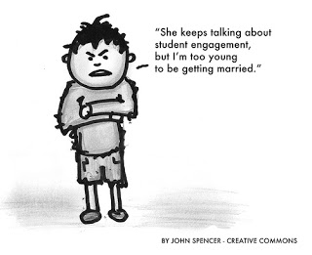
Compliant or Engaged?
What is the difference? Discuss with a conversation partner for 30 seconds.

Slide 22
Deep Engagement: Students take full ownership of learning activities, displaying high levels of energy, a willingness to ask questions, pursue answers, consider alternatives, and take risks in pursuit of quality. Engagement: Students begin taking ownership of learning activities. Their involvement shows concentration and effort to understand and complete the task. They do not simply follow directions but actively work to improve the quality of their performance. Active Compliance: Students participate in learning activities and stay on task without teacher intervention. However, their work has a routine or rote quality and significant thought or commitment to quality is not evident. Passive Compliance: Students follow directions in a rote or routine manner. Attention may be mildly distracted and they may need some added teacher attention or direction to remain on task. Periodic Compliance: Students’ attention and participation fluctuates. They appear 4 distractible and stall out easily when questions emerge. May require significant teacher attention and direction. Resistance: Students appear blocked, unable or unwilling to participate in learning activities. Classroom management procedures or redesign of learning activities may be required.

Slide 23
The big 3 C’s- our commitment to our students:
Connection- getting to know your students, knowing their strengths and weaknesses, praising when appropriate, incorporate humor, encourage creativity, teach social skills they may need help with, communicate the expectancy of success, peer tutoring/helping, teach empathy
Contribution- give them meaningful work to do, make learning experimental (try new things with them), classroom rules, choices in learning, encourage students to participate
Competence- positive and realistic expectations, logical consequences, flexible grouping, help them appreciate and understand diversity, give increasing responsibility, teach dignity and sportsmanship, give hope, start each day fresh!

Slide 24
It’s easy to blame students. They don’t care. They’re distracted with their phones and computers. They’re taking this class as an elective. They don’t think this course or the information is important. “Kids these days”, right?

Slide 25
Anchor Activities (pages 19-21)
One premise in a differentiated classroom: “ In this class we are never finished--- Learning is a process that never ends.”
The Purpose of an Anchor Activity is to:
Provide meaningful work for students when they finish an assignment or project, when they first enter the class or when they are “stumped”.
Provide ongoing tasks that tie to the content and instruction.
Free up the classroom teacher to work with other groups of students or individuals.

Slide 26
Peer Evaluations/Homework Discussion (page 22)
Pair discussions of homework. Have them go over certain answers. They must have the same answer, if not they need to discuss, find the answer and make the changes. On a sticky note they write down the question numbers that they differed on. Those are questions I now know I need to review.
Peer Evaluation Sheets. Give the students a checklist of what they need to look for on a given assignment. Simply put a check if they have it and a zero if they do not. Return to owners for improvement.

Slide 27
Learning Menus- Curriculum Playlist (pages 23-25)
Choice Engagement
Motivation Hands-On
Student-Centered Challenge
Learning Styles Individual Needs
Interests Independence
Build Upon Strengths Readiness

Slide 28
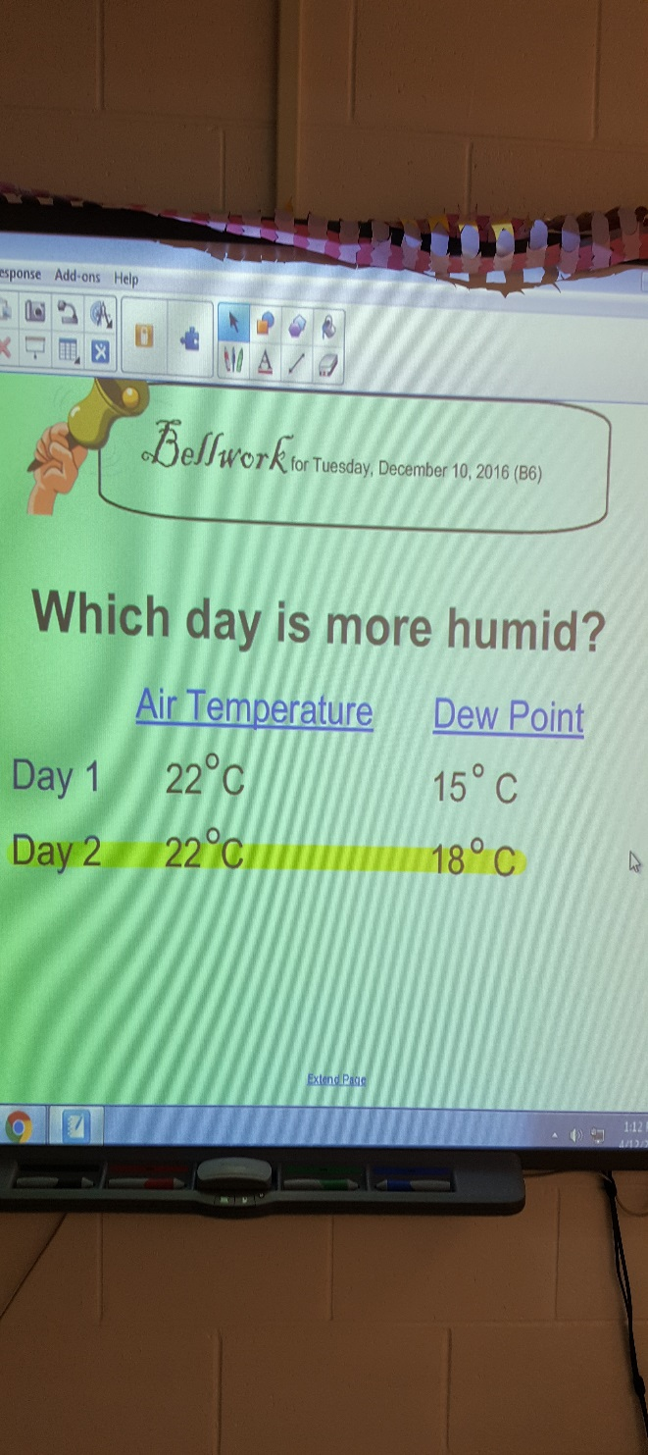
Bellwork
Effective Bell Work Activity Examples
• Review Questions – You may use questions from the textbook or create your own about the previous lesson.
• Introductory Questions –Use Bell Work to introduce topics and get students thinking about controversial or interesting ideas related to the lesson of the day.
• Reflective Questions – If you incorporate journaling into your instruction, then the beginning of class is the perfect time to give students the opportunity to journal. Create a question related to the topic of the day, current event, or liturgical year.
• Reading Assignment – In preparation for the day’s lesson you can have students read (or re-read) from the textbook.
• Graphic Organizers – Graphic organizers are ways for students to visually represent the things they have learned. Invite students to use their notes to complete these worksheets.
• KWL Charts – Have students create a KWL chart by folding their paper as if they were sending a letter. Write a topic on the board and have students write everything they know about the topic (under the K column) and everything they want to know (under the W column) and leave the third column blank (what I learned).
• Concept Maps (Mind Maps) – have students write everything they know about a topic (as review or introduction) in concept map form.
• “Entrance Cards” – similar to “Exit Cards,” these formative assessments allow you to view quick responses to questions as a review or an estimation of prior knowledge.

Slide 29
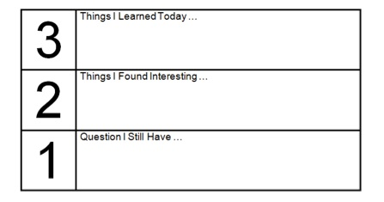
Exit Slips (pages 26-27)
Write one question you have about today's lesson
Write three words with the long "o" sound
Why are the North and South Pole so cold?
Explain why Canada is not considered a melting pot
Draw a quick diagram that shows perspective
Of the 3 graphs we studied today which one did you find most useful? Why?
Name one positive and one negative thing that happened during group work today
Multiply 3.72 and 7.32
Write one thing you learned today

Slide 30
Fun Fact(s) Friday
The black boxes in commercial aircrafts, are in fact orange (so does anybody know why it is called a black box?)
Snakes hear through their jaws.
Snails can sleep for three years without eating
You use more calories eating celery then there is in the celery itself
The earth weights abut 6,588,000,000,000 million tons. (how did they measure this?)
Teeth are the only parts of the human body that can't repair themselves
I have also used a song that relates to our curriculum on Fridays. Kids LOVE music and love when we can connect music to our curriculum.

Slide 31
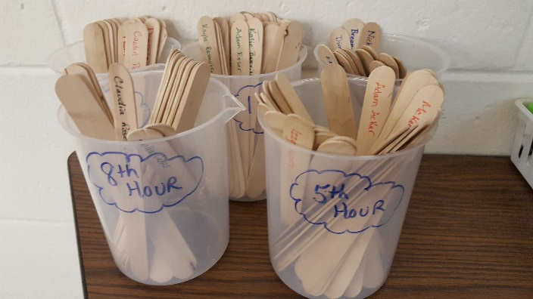
Popsicle Stick Partners – also called fairness cups.
Use Popsicle Sticks at any point in the lesson to increase engagement of all students and to show you value each person in the classroom. Use the sticks to:
1) Ask interest questions before introducing new material to tap into prior knowledge
2) Randomly call on students to gauge understanding during or after a lesson
3) Assign groups or tasks- this can be done ahead of time or randomly in front of the students.
4) Decide who will receive a special privilege

Slide 32
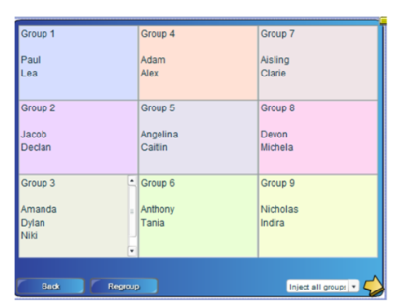
Group Generator
Students today, and always, have a fear of being left out. Think back to your earlier days, and maybe even today. The fear of being that one person without a partner or a group is a common fear. We all want to belong, to fit in.
Using a group generator alleviates that fear.
I start the year using it so the kids just expect when there is group work that I will have them grouped someway, somehow.
Rarely do I let the students choose who they are going to work with anymore. It is a practice that I have put aside knowing how sensitive students can be.

Slide 33
Stick It
Make use of those sticky notes by having each class write down something they learned in class. OR have them write a question they had in class today. A great way for you to review what stuck and what did not! I keep them posted for all the classes to see the next day. Students tend to learn from other students writing!

Slide 34
Student Questioning
Switch it up. Teach the way they learn. Try different teaching methods. Consider flipping your classroom! Get them to share and explain concepts to each other. It’s the best way for them to really know whether or not they’re “getting it”.

Slide 35
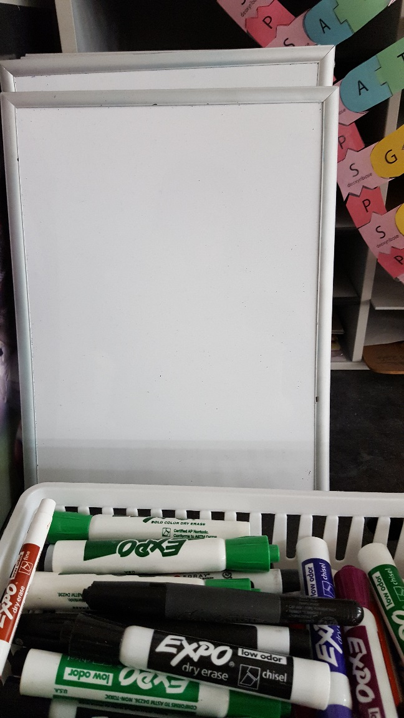
Fact or Fiction Questioning
This is used to practice content and show what you know.
Form groups of 3-5 members (use random group generator or popsicle sticks)
Using content (maybe a quiz review or information from a text reading) one student poses a question.
One student responds with the true answer (fact) and two false answers (fiction).
The other group member or members guess which is the fact.
They continue to switch roles.
Using white boards for this activity is quite fun for the kids.
Example: What is the second stage in mitosis?
Student Responds with: anaphase, prophase, metaphase
* Students have self created multiple choice questions.

Slide 36
Kahoot Kahoot Web
Kahoot is a great platform for creating a fun, social and game-like environment in the classroom.
Ask thought provoking questions
Students, take control of their own learning
Easy-to-use, inclusive & highly engaging
Con’s to Kahoot- Students answer WAY too fast.
Now there is a Quizlet Live. I have not tried yet, but seems to have engaging qualities worth giving a try!

Slide 37
Quia Quia Web
1) Students do not have to wonder if their answer is correct or not as they answer a question.
2) Students can answer without feeling badly about having a wrong answer as can happen in a class. No other student knows.
3) Students can retake a practice quiz as often as they want to improve their score.
4) Teachers can quickly analyze in what areas students are successful and in what areas they have demonstrated learning gaps.
5) Can be a time saver for teachers.
6) Both students and teachers can see the students’ progress over time as they see the online quiz scores.

Slide 38
Read Aloud (READ ALOUD OFTEN)
Most of the material kids read in school, no one would read for pleasure. And if all your reading is tied to work, you develop a sweat mentality to reading, so by the time you graduate you can’t wait to stop reading. You become a school-time reader, not a life-time reader. Of course, kids have to do a certain amount of reading that’s tied to work, but you don’t want kids to forget that there are books out there to make you laugh, make you cry, and move the soul.
Reading aloud provides opportunities for extended discussions.
Reading aloud with older readers is pleasurable.
Reading aloud connects readers with content area subjects.
Reading aloud provides access to books that readers may not be able to experience on their own.

Slide 39
Station Learning
Guesstimate how long it should take each group to complete the activities in all of your learning stations. Recognize that some activities will take longer than others. Always have more learning stations than groups. This way, you don't have a team idle, waiting for a station to open up. Have the next assignment ready in advance. For example, "If you finish your stations early, you may quietly begin working on today's homework assignment." For noisy stations, provide headphones. Space out each station as best as you can so that groups are not bumping into one another. Your first time doing this with a class, give very explicit instructions on each station and its assignment/task. Be prepared to monitor the students closely and answer a lot of questions. But once the students have mastered their first batch of learning stations, they will be prepared for the next "learning stations day" and know exactly what they do and what is expected of them.
Implement the “ask three before me” rule, as there is only one of you!

Slide 40
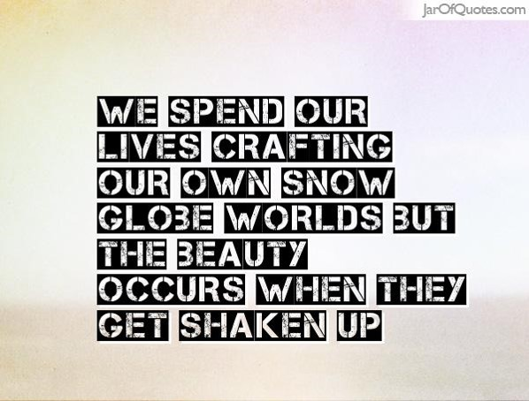
Now what?
No matter the level of teaching experience we have all encountered moments where we feel disconnected from our students. This hardly means we are an awful teacher and need to forget everything we have learned and start over, but simply react. Find the best way to connect with students and realize that not all connections will suit every student. Connections can be made through a variety of ways. The key is not to overhaul the entire system, but simply adapt and change as you progress. Set a course for learning and be prepared for rough seas. Create a practical alternative or adaptation that blends elements of what we have been doing and what we would like to do better. The connections will follow.

Slide 41
Your Key to Engagement: Mix It UP!
1. Don't just care...really care!
2. Speak to every student at least once every class period - the more the better!
3. Meet your students where they are; not where they are supposed to be, or where you want them to be...
4. Have high expectations, and expect the best from every single student every single day!
5. Do whatever it takes to get your students out of their desks, and give them every opportunity to use their arms and legs!
6. Focus on the three R's - rigor, relationships, and relevance...
7. Most importantly...give your students a voice and involve them in the educational process!
Talk to others, use Pinterest, use your natural creativity. Just the other day I thought of an activity and just tried. The kids loved it!

Slide 42
To Conclude:
Maya Angelou once said, “I’ve learned that people will forget what you said, people will forget what you did, but people will never forget how you made them feel.”
Everyday give all you have to your students. You will be tired, even exhausted. But teaching with your whole heart gives those students an experience they will not soon forget. Every child deserves that.

